Slide 1

UNIVERSITY INSTITUTE OF ENGINEERING
COMPUTER SCIENCE ENGINEERING
Bachelor of Engineering (Computer Science & Engineering)
Subject Name: Big Data Analytics
Subject Code: 20CST-471
Importance of big data
Mapped with CO1
Prepared By:
Er. Ankita Sharma
DISCOVER . LEARN . EMPOWER

Slide 2
Importance of big data
The importance of Big Data in today's business landscape cannot be overstated.
Big Data serves as a catalyst for informed decision-making, offering organizations unprecedented opportunities to gain insights from vast and diverse datasets. One of its key values lies in its ability to reveal patterns, trends, and correlations that might otherwise remain hidden in traditional data sources.

Slide 3
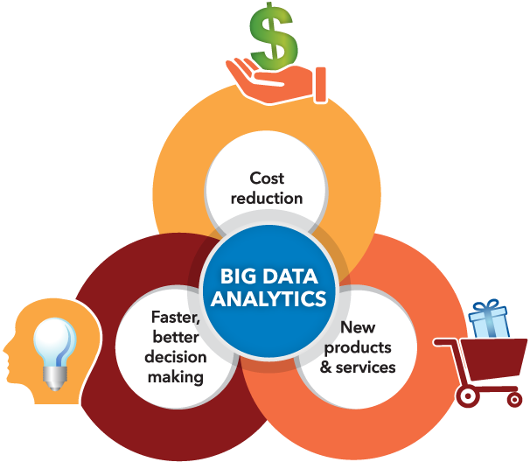
Moreover, Big Data plays a crucial role in enhancing operational efficiency. By harnessing large datasets, organizations can identify areas for improvement, streamline workflows, and reduce inefficiencies.

Slide 4

The application of Big Data extends beyond internal operations to customer-centric strategies.
Analyzing customer behavior and preferences allows businesses to tailor products and services, personalize marketing efforts, and ultimately enhance the customer experience. This personalized approach not only fosters customer loyalty but also opens avenues for revenue growth.

Slide 5
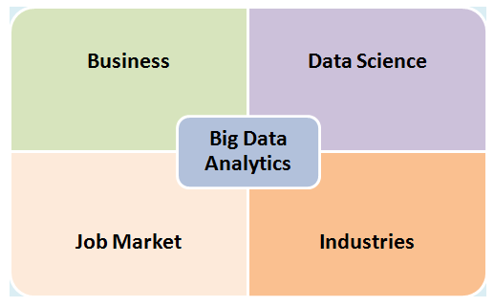
In addition to its impact on individual businesses, Big Data has broader implications for societal advancements.
It fuels research in various fields, including healthcare, where the analysis of large-scale health data can lead to breakthroughs in disease prevention and treatment. It also contributes to smart city initiatives, optimizing urban planning and resource management.

Slide 6
As technology continues to evolve, the importance of Big Data will only intensify.
The ability to harness, analyze, and derive meaningful insights from vast datasets is becoming a competitive differentiator across industries.
Businesses that embrace Big Data analytics are better positioned to adapt to change, capitalize on emerging trends, and navigate the complexities of the modern digital landscape. In essence, Big Data is not just a tool for data analysis; it is a strategic asset that empowers organizations to thrive in an era where information is a cornerstone of success.

Slide 7
Businesses that embrace Big Data analytics are better positioned to adapt to change, capitalize on emerging trends, and navigate the complexities of the modern digital landscape. In essence, Big Data is not just a tool for data analysis; it is a strategic asset that empowers organizations to thrive in an era where information is a cornerstone of success.

Slide 8
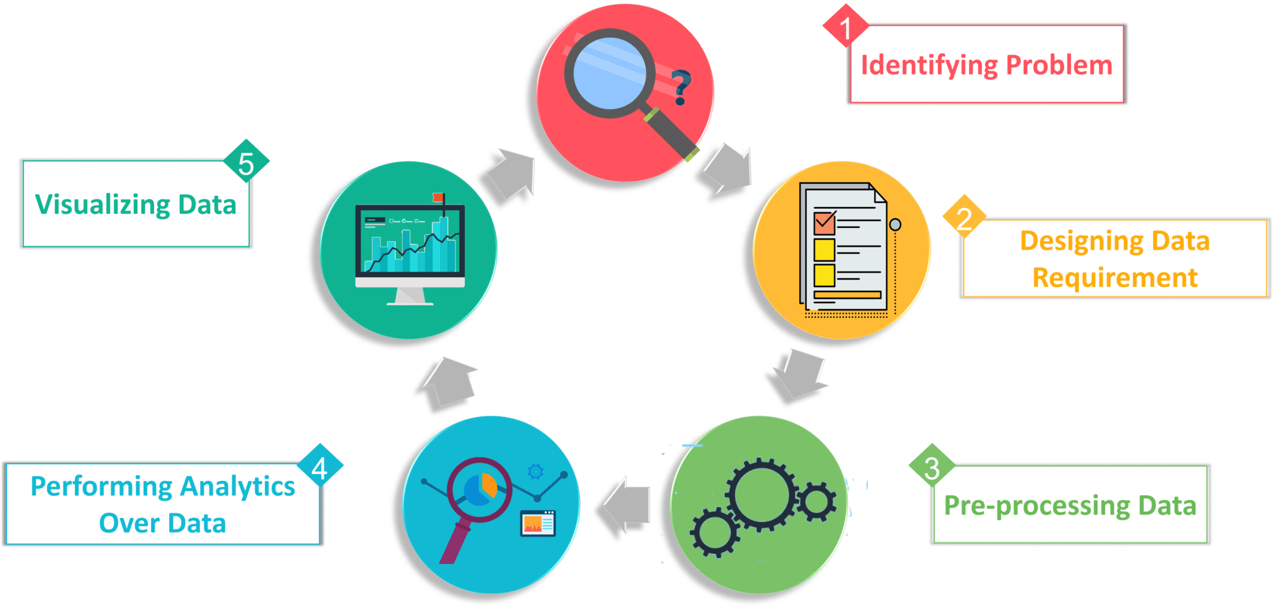

Slide 9
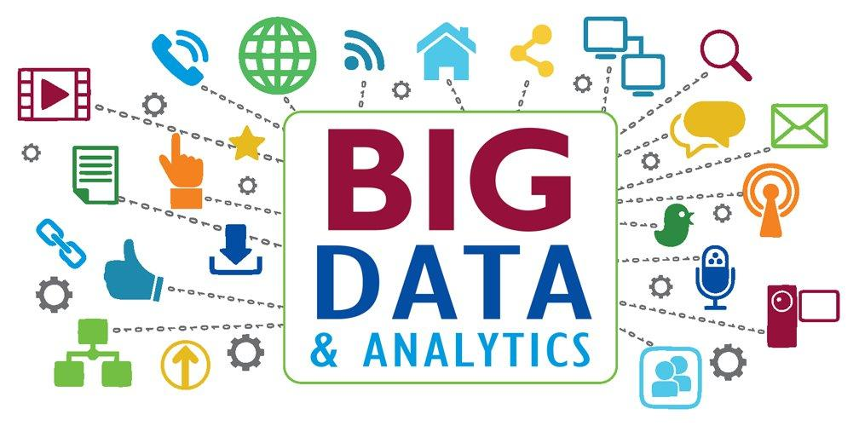

Slide 10
Thankyou

